Slide 1


TCS – Stock Price Prediction
Presented By – Group 6
Ayushman Dash
Dhanashree Milind Kulkarni
Nagesh N
Rahul Kumar Yadav
Rohan Sanjay Barse
Yuvraj Sunil Devrukhkar
Akshith P G
Mentor : Aishwarya Mate

Slide 2
Contents
Objectives
Project Structure
Data Collection and Details
EDA
Data Visualization
Feature Extraction
Model Building and Evaluation
Model Deployment

Slide 3
1. Objectives
Stock price prediction aims to forecast the future movement of a stock's price based on historical data and various factors such as market trends, company performance and investor sentiment. The goal is to make informed investment decisions, including buying, selling, or holding stocks, with the aim of maximizing profits or minimizing losses. Stock price prediction provides investors with insights into potential future price movements, helping them make more informed decisions in the volatile and uncertain world of financial markets. The objective is to understand the underlying structure in TCS Stock Price data and come up with a suitable forecasting model that can effectively forecast for the next 30 Days.

Slide 4
2. Project Structure
6. Model Deployment
1. Business Understanding
2. Data Collection
5. Model Evaluation
4. Exploratory Data Analysis
3. Data Preparation

Slide 5
3. Data Collection and Details
The Stock Price data for TCS (Tata Consultancy Services) is obtained from Yahoo Finance.
The dataset has 5260 Rows and 7 Columns.
The date of the data ranges from 2003-01-01 to 2024-02-29.
These are the following columns in the dataset-
Date: The date on which the stock data was recorded.
Open: The price at which the stock started trading.
High: The highest price the stock reached during the trading session.
Low: The lowest price the stock reached during the trading session.
Close: The final price at which the stock traded at the end of the trading session.
Adj Close (Adjusted Close): The closing price of the stock adjusted for any corporate actions that may affect comparability.
Volume: The total number of shares traded.

Slide 6
4. EDA – Exploratory Data Analysis
Exploratory Data Analysis (EDA) involves analyzing and summarizing the main characteristics of a dataset to understand its structure and uncover patterns and relationships.
Loading the Dataset: Start by loading the TCS dataset into your preferred data analysis environment, such as Python with pandas, or R.
Data Summary: Use functions like `head()`, `info()`, and `describe()` to get an initial overview of the dataset. This includes checking for missing values, understanding the data types of each column, and getting summary statistics.
Time Series Analysis: Since this is stock price data, it's likely a time series. You can use tools like line plots, histograms, and autocorrelation plots to understand the distribution, trends, and seasonality in the data.
Data Cleaning: Address any missing or erroneous data. This might involve imputing missing values, handling outliers, or correcting errors.

Slide 7
Feature Engineering: Create new features that might be useful for analysis or prediction. For example, you could create moving averages or lag features.
Data Visualization: Visualize the data using plots such as line plots, scatter plots, and histograms to gain insights into the data distribution and relationships between variables.
Statistical Analysis: Perform statistical tests to investigate relationships between variables or to test hypotheses.
Correlation Analysis: Use correlation matrices or scatter plot matrices to identify relationships between variables.

Slide 8
Outlier Detection: Identify and potentially remove outliers that might distort your analysis.
Seasonality and Trends: Use decomposition techniques to separate the time series into its components (trend, seasonality, and residuals) to better understand its behavior.
Stationarity: Check for stationarity in the time series data, as many time series models assume stationarity.
Data Transformation: If necessary, apply transformations such as differencing or logarithmic transformations to make the data more stationary.

Slide 9
Feature Importance: Use methods like correlation analysis or feature importance from machine learning models to understand which features are most important in predicting stock prices.
Data Segmentation: Consider segmenting the data based on different criteria to analyze subsets of the data separately.
Data Normalization: Normalize the data if you plan to use algorithms that require it, such as neural networks.
Dimensionality Reduction: Use techniques like PCA (Principal Component Analysis) to reduce the dimensionality of the dataset and identify the most important features.
These are just some of the common steps involved in EDA.

Slide 10
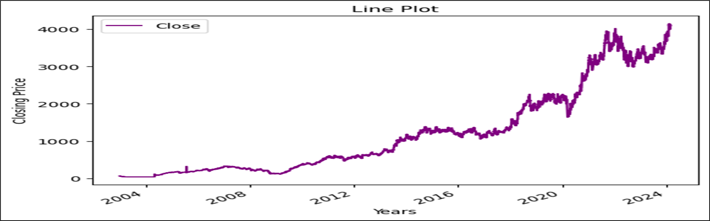
5. Data Visualization
For data visualization of the TCS dataset, we have used various Python libraries such as Matplotlib, Seaborn, and Plotly. Here are some common types of visualizations you can create:
Line Plot: Show the trend of TCS stock prices over time.

Slide 11
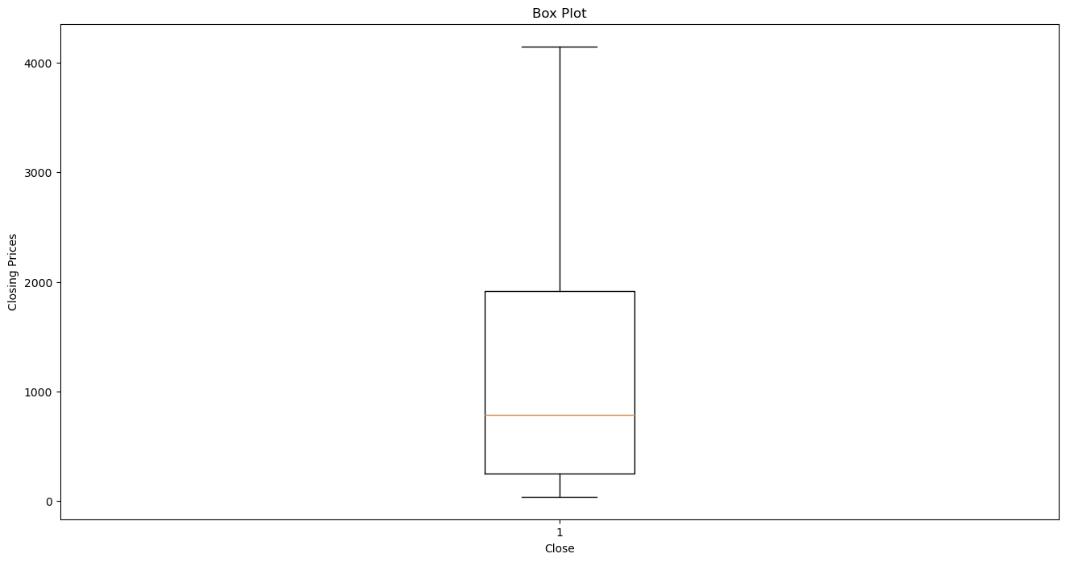
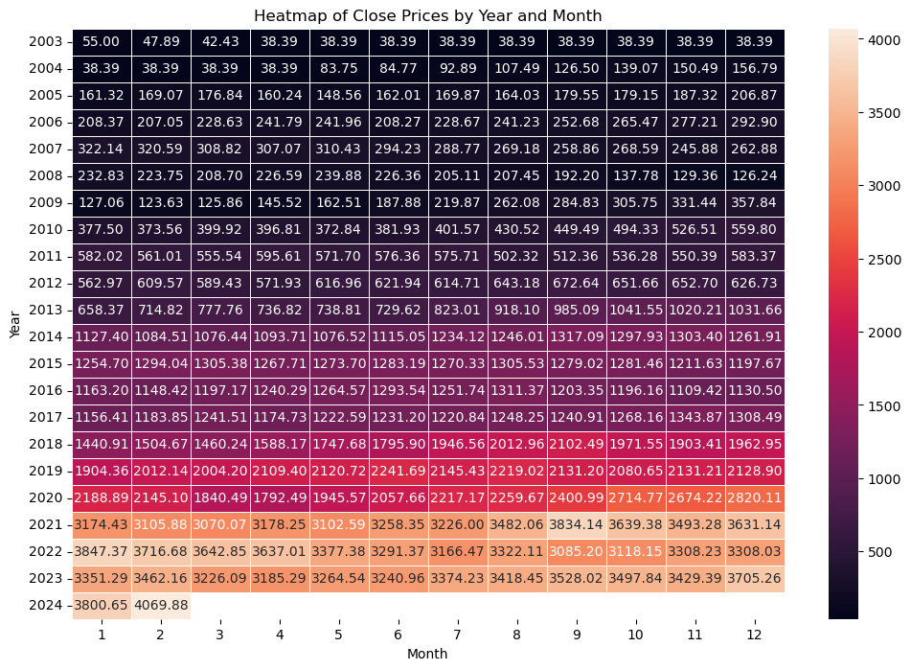
Box Plot: Visualize the distribution of TCS stock prices, highlighting the median, quartiles, and outliers.
Heatmap: Show the correlation matrix of TCS stock price and volume data

Slide 12
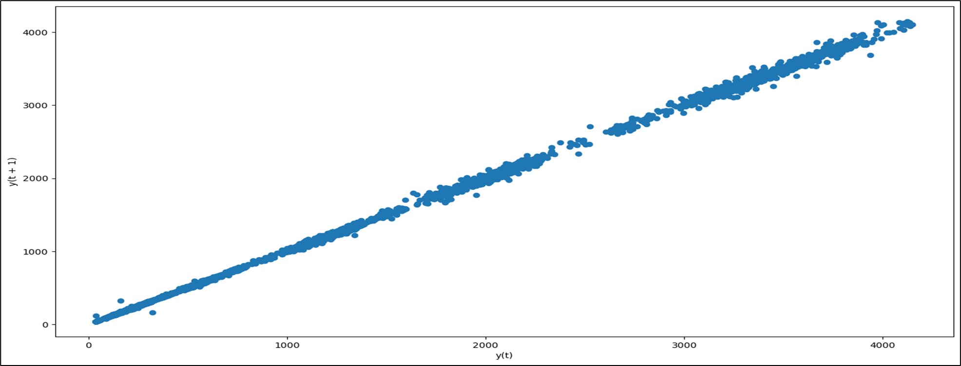
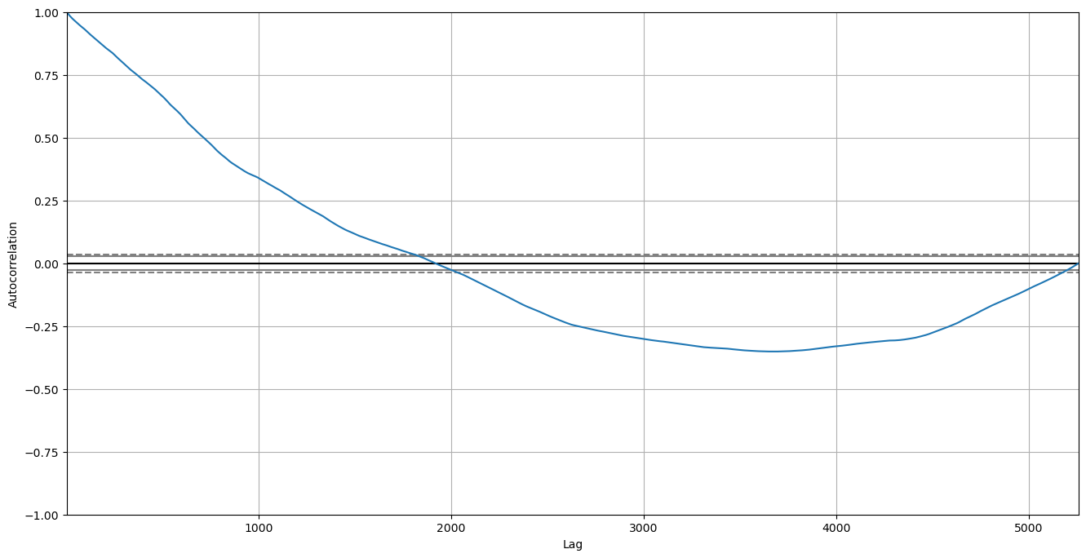
Lag Plot: Shows the specific trend indicate that each data point is strongly correlated with its lagged values.
ACF & PACF: The pattern in the autocorrelation plot suggests positive autocorrelation at small lag values which decreases as lag value increases. For the partial autocorrelation plot it suggests the suitability of an autoregressive model with a lag order of 2

Slide 13
6. Feature Extraction
Feature engineering involves extracting meaningful information from data by selecting, creating, or transforming features. This process enhances the performance of machine learning models by providing them with relevant and informative input variables.
Date Features: Extract features such as day of the week, month, quarter, and year from the date column, as these could capture potential seasonal or cyclical patterns.
Lag Features: Create lag features by shifting the closing price by a certain number of time steps, which can capture autocorrelation in the data.
Price Change: Calculate the percentage change in the closing price from the previous day, which can capture volatility in the data.
High-Low Spread: Calculate the difference between the high and low prices, which can indicate price volatility.

Slide 14
7. Model Building and Evaluation
To build and evaluate a model for stock price prediction using the TCS dataset, you can follow these general steps:
Data Preprocessing: Prepare the dataset by handling missing values, encoding categorical variables (if any), and splitting the data into training and testing sets.
Feature Selection: Select the relevant features from the dataset to use as inputs for the model. You can use techniques like correlation analysis or feature importance to guide your selection.
Model Selection: Choose a machine learning model suitable for time series forecasting. Some common models for this task include LSTM (Long Short-Term Memory) neural networks, ARIMA (Autoregressive Integrated Moving Average), and Prophet.

Slide 15
Model Training: Train the selected model using the training dataset. For neural networks like LSTM, you may need to reshape the input data into a 3D array (samples, time steps, features).
Model Evaluation: Evaluate the trained model using the testing dataset. For regression tasks like stock price prediction, common evaluation metrics include Mean Absolute Error (MAE), Mean Squared Error (MSE), and Root Mean Squared Error (RMSE).
Prediction: Make predictions using the trained model on the test dataset.
Visualization: Visualize the predicted stock prices against the actual prices to understand the model's performance

Slide 16
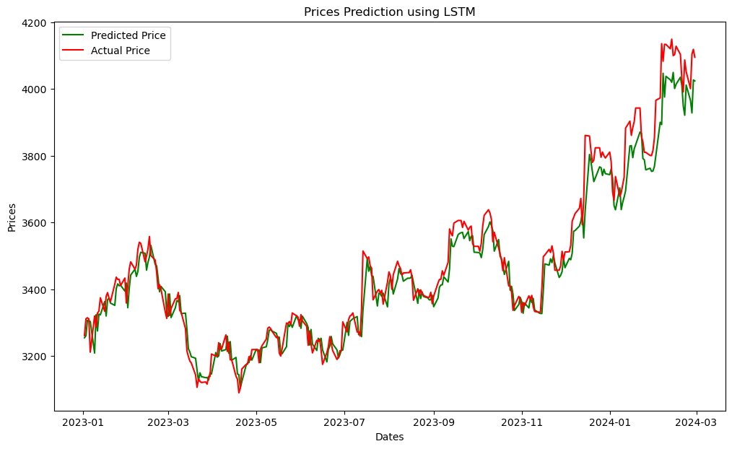
LSTM

Slide 17
8.Model Deployment
To deploy a model for predicting TCS stock prices, you can follow these general steps:
Model Training and Serialization: Train your model using the TCS dataset and serialize it (save it to a file) using a library like joblib or pickle in Python
Web Application Setup: Set up a web application framework like Flask or Django to create a web interface for users to interact with your model.
Model Loading: Load the serialized model in your web application code to make predictions.
Input Processing: Process user inputs (e.g., date, volume, moving averages, RSI) to match the format expected by your model.

Slide 18
Prediction: Use the loaded model to make predictions based on the user inputs.
Output Presentation: Present the prediction results to the user through the web interface.
Deployment: Deploy your web application to a web server, cloud platform (e.g., AWS, Azure, Google Cloud), or a platform-as-a-service (PaaS) provider.
Testing and Monitoring: Test your deployed application thoroughly to ensure it works as expected. Monitor the application for performance and accuracy.

Slide 19
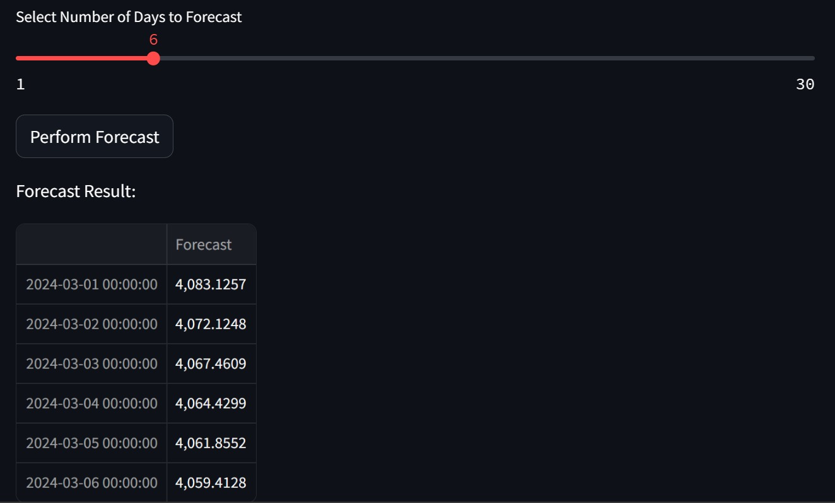
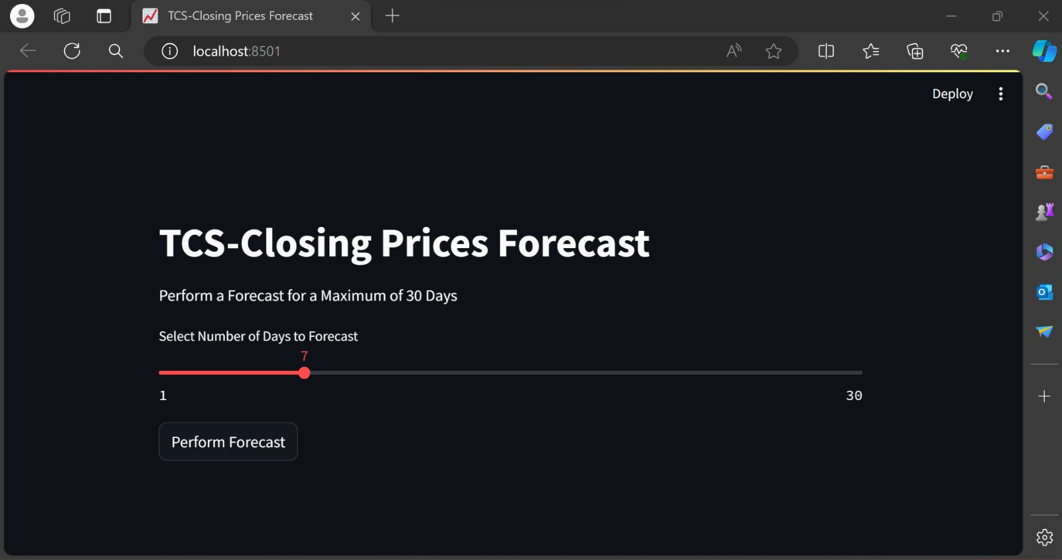
Web Deployment
Here we did deploy the model into web page for future predication using stremlit module in the python for easy to use

Slide 20
Problem Faced
Data Quality and Quantity: Insufficient or poor-quality data can lead to inaccurate predictions. Ensuring that you have enough historical data and that it is clean and relevant is crucial.
Feature Selection: Choosing the right features or input variables for your model is essential. Selecting irrelevant or redundant features can lead to poor performance.
Model Complexity: LSTM models can be complex, and tuning the model architecture and hyperparameters can be challenging. Finding the right balance between model complexity and performance is crucial.
Deployment: Deploying LSTM models into production environments can be complex, especially if real-time predictions are required. Ensuring that your deployment pipeline is robust and scalable is essential.
Training Time: Training LSTM models can be computationally intensive, especially with large datasets or complex models. Optimizing your model and using efficient hardware can help reduce training time.

Slide 21


